Slide 1


Slide 2
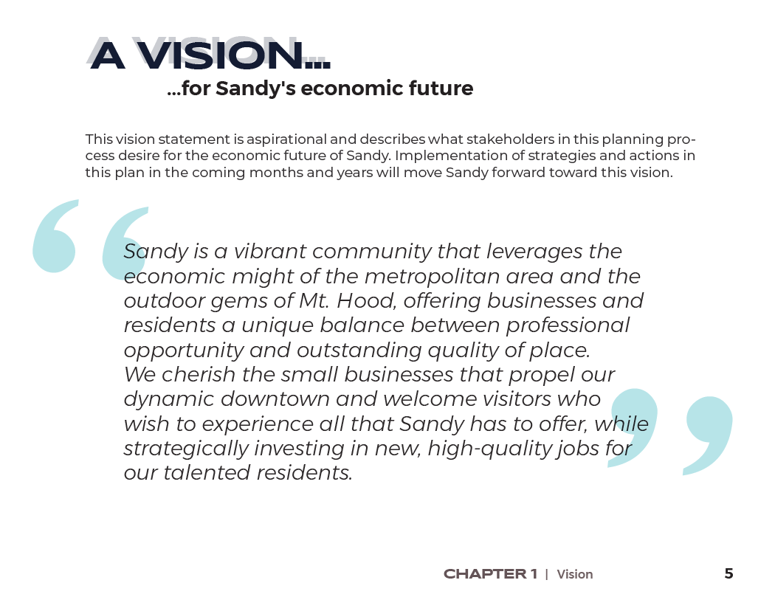
Vision and Goals
Vision Statement
Sandy is a vibrant community that leverages the economic might of the metropolitan area and the outdoor gems of Mt. Hood, offering businesses and residents a unique balance between professional opportunity and outstanding quality of place. We cherish the small businesses that propel our dynamic downtown and welcome visitors who wish to experience all that Sandy has to offer, while strategically investing in new, high-quality jobs for our talented residents.
The vision state is unchanged since the March 1 EDAB meeting.
Notes:
CM

Slide 3
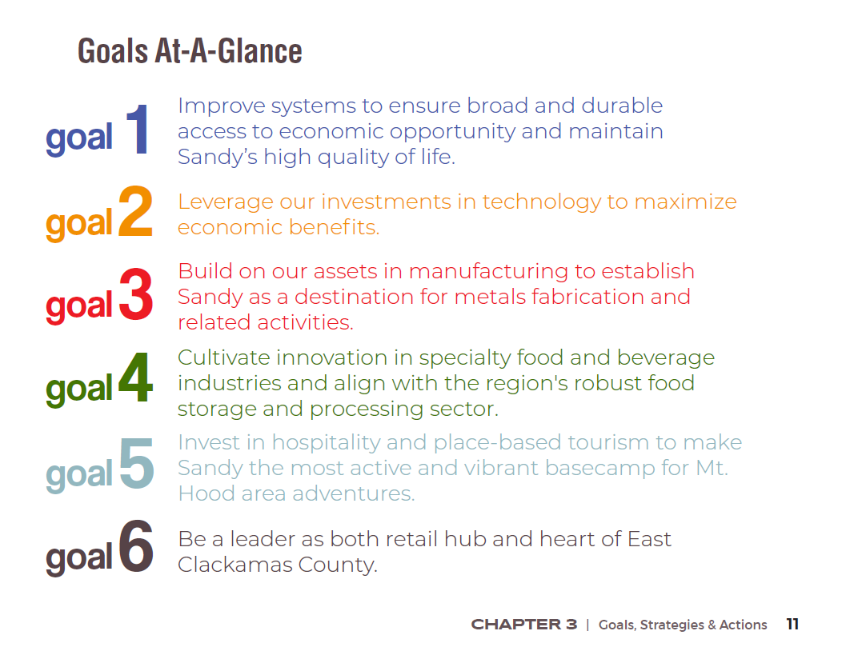
Vision and Goals
The goals are unchanged since the March 1 EDAB meeting.
Notes:
CM

Slide 4
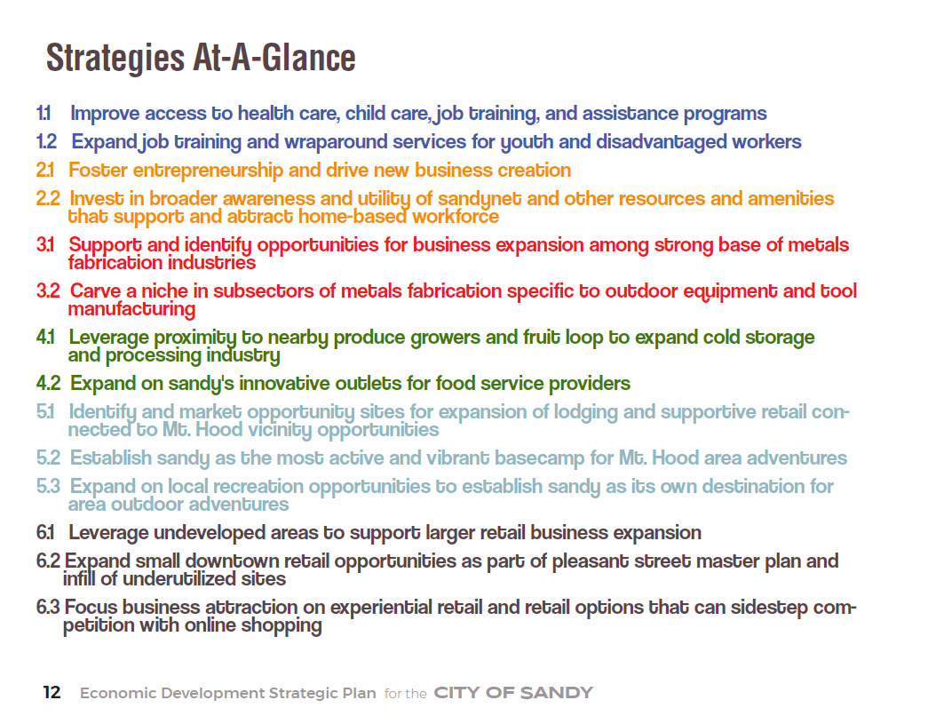
Strategies
The strategies are unchanged since the March 1 EDAB meeting.
Notes:
CM

Slide 5
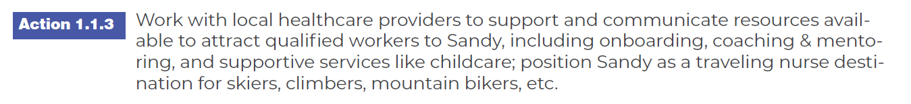
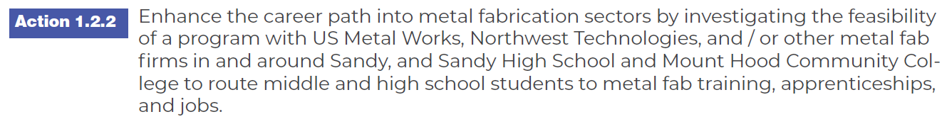
Changes from previous draft…
OLD: Action 1.1.3 – Establish an incentive program to attract qualified workers to health care settings in Sandy.
OLD: Action 1.2.2 – Enhance job recruitment program for metals fabrication and related industries to improve job access for Middle and High School students.
Notes:
CM

Slide 6
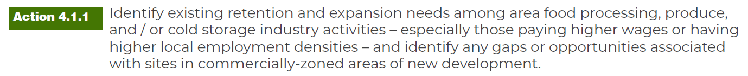
Changes from previous draft…
OLD: Action 3.2.2 – Identify opportunity sites for both expansion and recruitment of metals fabrication and outdoor tool manufacturing and equipment providers that responds to notable land constraints in the Economic Opportunity Analysis.
OLD: Action 4.1.1 – Identify existing retention and expansion needs among nearby food processing, produce, and cold storage industries and identify any gaps or opportunities associated with sites in new development areas.
Notes:
CM

Slide 7
Changes from previous draft…
OLD: Action 5.2.3 – Strengthen transit network connections to support travel link to Mt. Hood adventures and areas of Columbia Gorge, including all ski resorts in Clackamas and Hood River Counties.
Notes:
CM

Slide 8
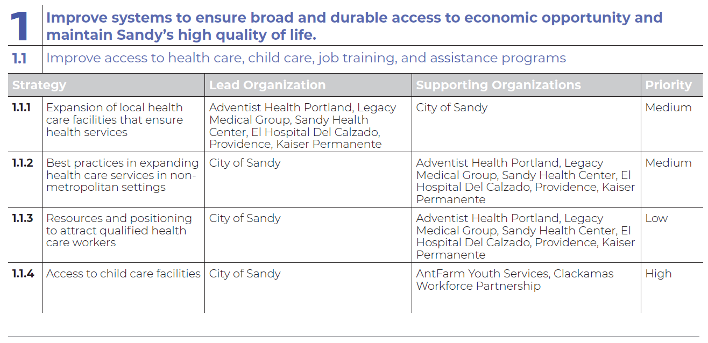
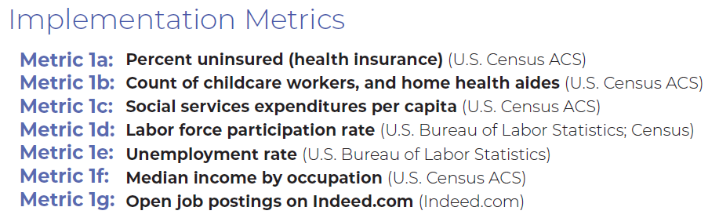
Getting started…
Notes:
CM

Slide 9
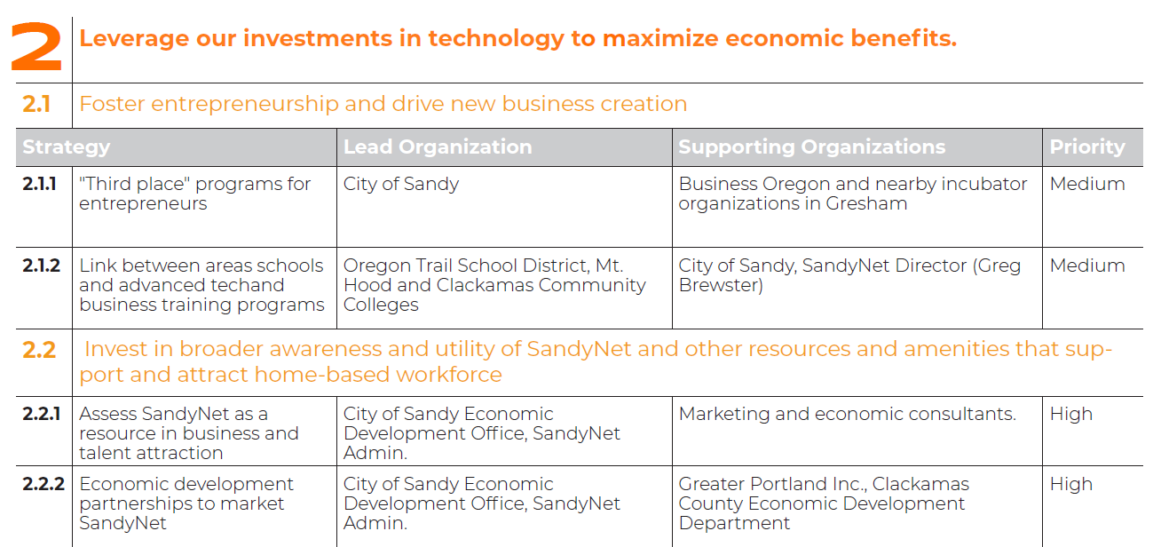
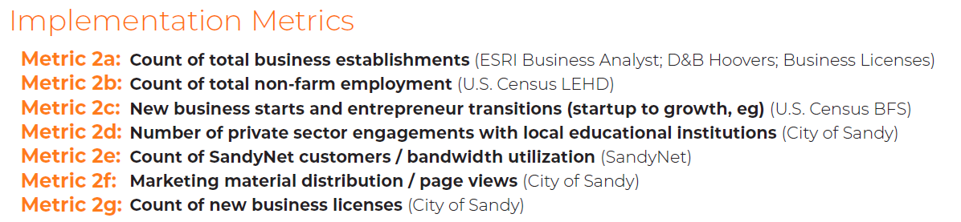
Getting started…
Notes:
CM

Slide 10
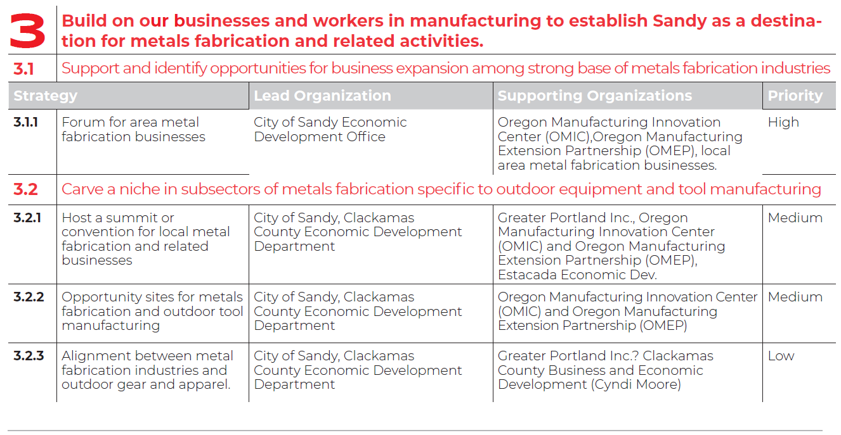
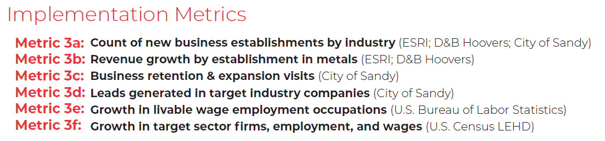
Getting started…
Notes:
CM

Slide 11
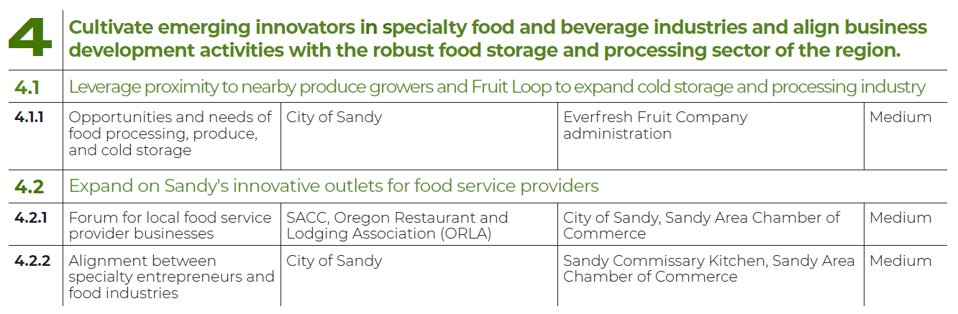
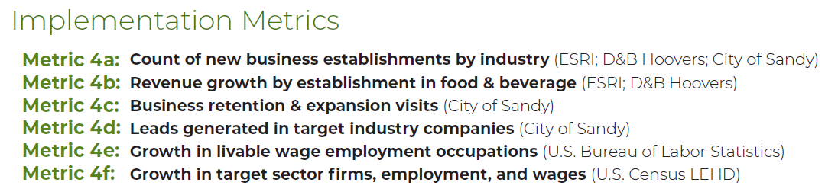
Getting started…
Notes:
CM

Slide 12
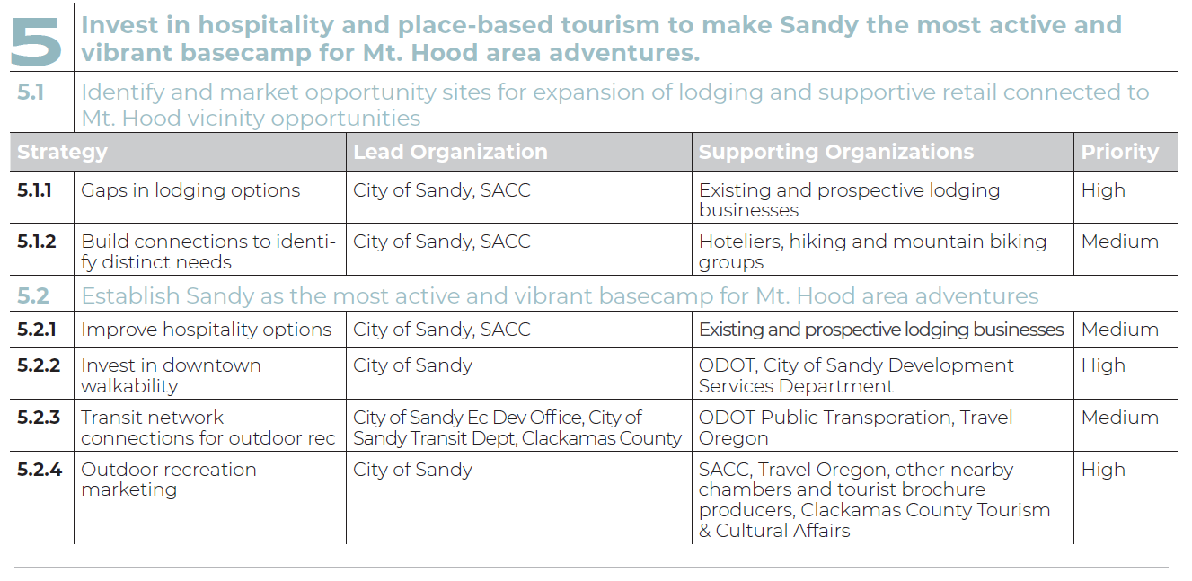
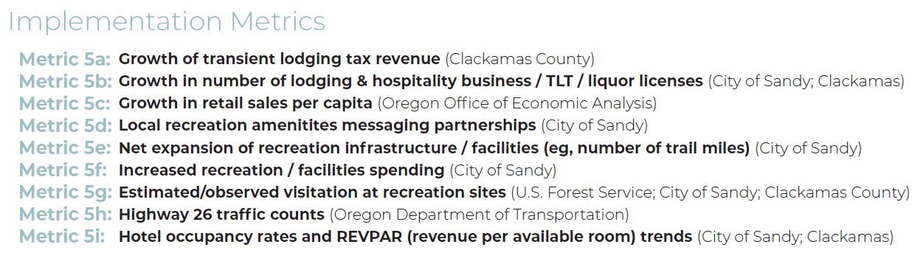
Getting started…
Notes:
CM

Slide 13
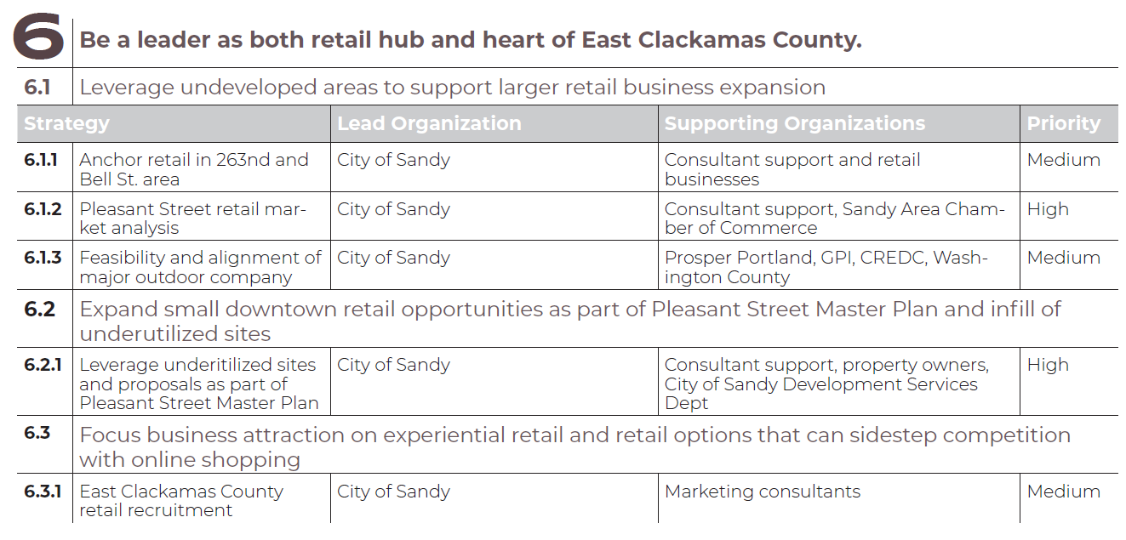
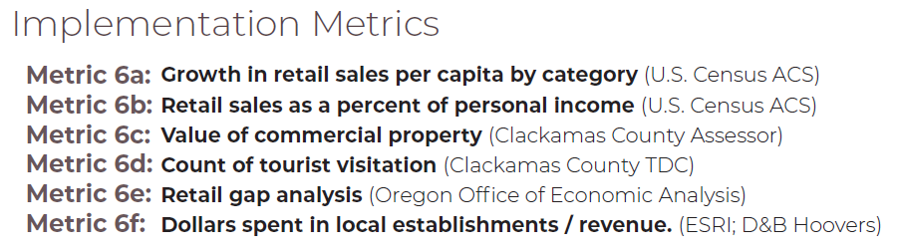
Getting started…
Notes:
CM

Slide 14
Next Steps
With your recommendation…
…to City Council for adoption!
Notes:
CM

Slide 15


?
Thank you!

