Slide 1
City of Sandy Community Survey
Preliminary Results
Raw data is available at https://ci.sandy.or.us/survey
Notes:
Responses are available online

Slide 2
Survey Methodology
89 Questions
77% Completion Rate
21 Minute Average Survey Time
1824 Written-In Comments
+/-4% at the 98% confidence level
1091 Total Responses
797 Within City Limits
Open from Jan 26 to Feb 23

Slide 3

Methodology Cont.
Sources (Convenience Sampling)
City of Sandy Website
Facebook Post & Ad
Sandy Source Newsletter
Sandy Standard Ad
Water Bill Paper Insert
Front Counter at City Hall
Neutral or “Fair” are not considered positive responses in this report
Three Grouped Outcomes (Bad, Neutral, Good)
Notes:
Convenience Sampling, also known as haphazard sampling or availability sample. Little effort is made to ensure that the sample selected for the research is representative of the population of interest. Consequently, error bias may be included in the sample, and the research may lack generalizability. Research Methods and Statistics for Public and Nonprofit Administrators: A Practical Guide. Masami Nishishiba, Matthew Jones, Mariah Kraner. 2014. P.83.

Slide 5
Respondent Demographics
73% of responses are in city limits; 17% are outside, but in Sandy zip code
Majority of respondents have lived in Sandy 10+ years
Q1 & Q3

Slide 6
Respondent Demographics
86% are homeowners in single family homes; <12% rent
Over 95% of respondents are 30-65+ years of age; 18-29 <5%
Q4, Q5 & Q6

Slide 7
Community Image and Reputation
Reputation: 59% of respondents say Sandy’s reputation is “Good”
Comparison: 67% believe Sandy is “Better” than other cities
Q7 & Q8

Slide 8
Community Image and Reputation
Retention: Over 70% plan to remain in Sandy for at least 5 years
Q9

Slide 9
Direction of the City
Sentiment:
41% Wrong Direction
34% Indifferent
25% Right Direction
Q10

Slide 10
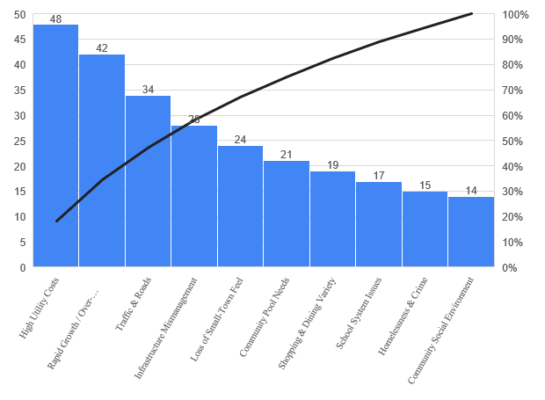
Community Image and Reputation Write-In’s
Q12

Slide 11
Public Safety Metrics
General Safety: 79% feel safe in Sandy; 82% feel safe in their neighborhood
Police Quality: 71% rate Sandy PD services as “Good” or “Excellent”
Q13 & Q21

Slide 12
Public Safety Metrics Cont.
Automated Traffic Enforcement: Divided; 37% useful vs. 36% no benefit
Q28

Slide 13
Public Safety Priorities
Theft Prevention: 92% say it is “Important”
Community Policing: 82% say it is “Important”
Traffic/Speed Enforcement: 80% say it is “Important”
Q25 & Q26

Slide 14
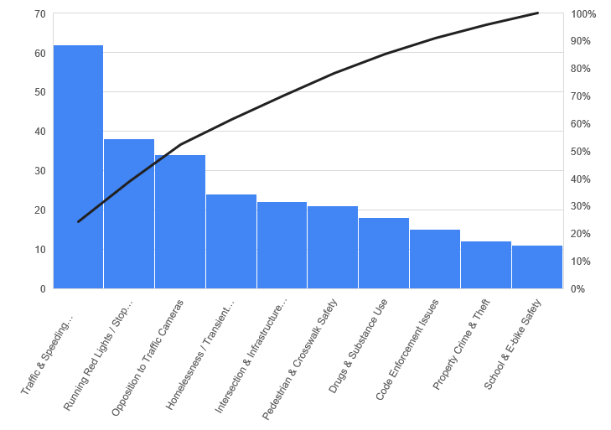
Public Safety
Write-In’s
Q29

Slide 15
Local Economy & Employment
Economic Health: 45% say it is “Fair”; 33% say it is “Good”
Jobs: 41% rate local employment opportunities as “Poor”
Infrastructure: 75% support continued investment in city-owned infrastructure
Q30 & Q34

Slide 16
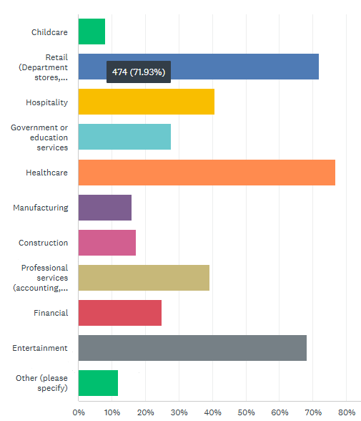
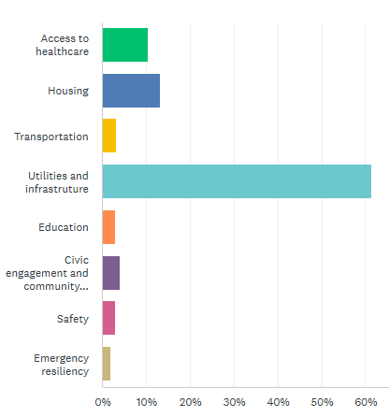
Consumer Habits & Gaps
Livability Barrier: 61% cited Utilities/Infrastructure as the top issue that Sandy is facing
Out-of-Town Services: Residents leave Sandy for Healthcare (77%), Retail (72%), and Entertainment (68%)
Q40 & Q41

Slide 17
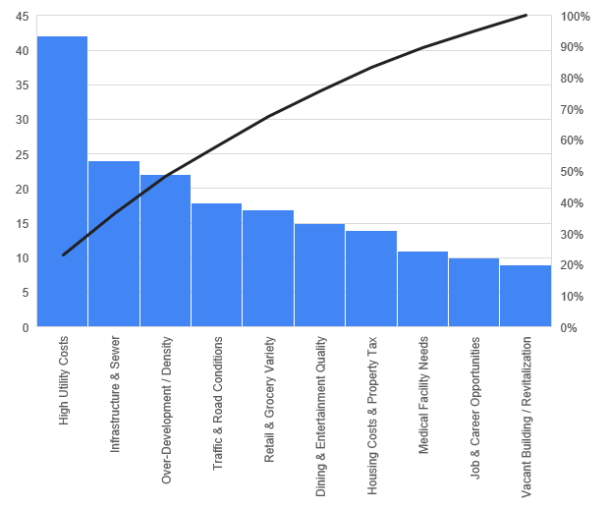
Local Economy
Write-In’s
Q42

Slide 18
Transportation & Mobility
City Street Flow: 59% rate major streets as being “Good” or “Excellent”
Downtown Pain Points: 43% rate downtown/highway traffic flow as “Poor”
SAM Transit: 74% believe the fare price is correct
Q42, Q43, Q52

Slide 19
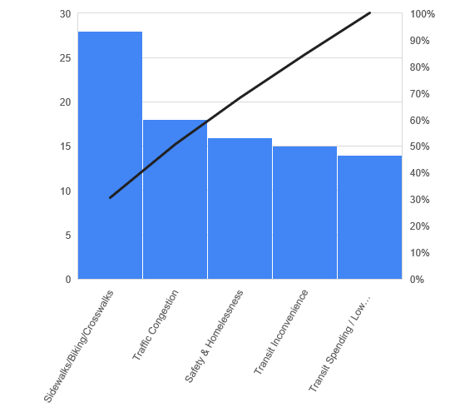
Transportation and
Mobility Write-In’s
Q52

Slide 20
Parks and Recreation & Library
Park Quality: 73% rate it as “Good” or “Excellent”
Winterfest Quality: 80% rate it as “Good” or “Excellent”
Community Center: 82% positive experience rating
Q57, Q58, Q61

Slide 21
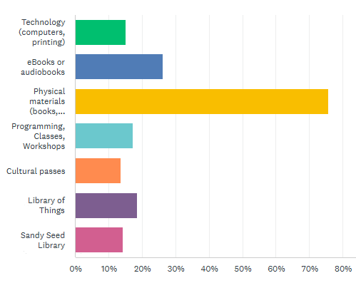
Parks and Recreation & Library Cont.
Library: Physical books remain the primary offering; About 75% say that the technology and level of electronic material is “Good” or “Excellent”
Q66, Q67, Q68

Slide 22
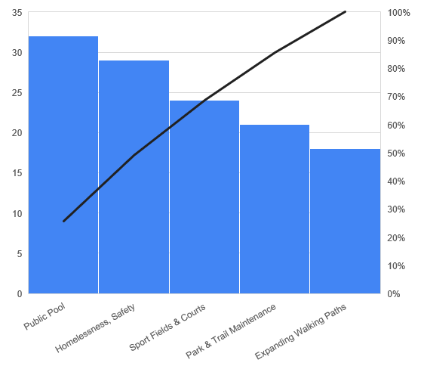
Parks and Rec
Write-In’s
Q64

Slide 23
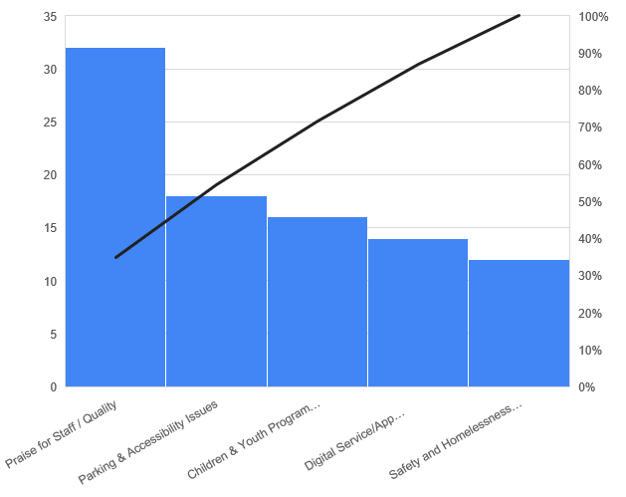
Library Write-In’s
Q73

Slide 24
Public Engagement & Interaction
Interaction: 47% have engaged with the city over the last year
City Experience: 68% reported a positive experience from their interaction
Information Gap: 31% feel “Uninformed” about city goals; only 9% feel very informed
Q74, Q75, Q79

Slide 25
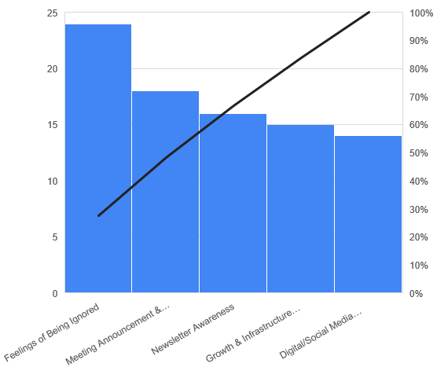
Public Engagement
Write-In’s
Q84

Slide 26
Overall Quality of LIfe
Personal View: 84% rate their quality of life as “Good” or “Excellent”
Community View: 67% say Sandy’s collective quality of life is “Good” or “Excellent”
Q88, Q89

Slide 27
Comments, Concerns, Follow Up Requests, Etc.

